Slide 1

LMN
Financial Group Network
Batch No – Y1S2.WD.CSNE.01 Group No – Y1S2.WD.CSNE.01_ 09

Slide 2
Group Member Details
Student ID number | Student name
IT23695702 | Robinshanth Tharnikan
IT23695870 | Gunawardana B.M.D
IT23651692 | Abichek M
IT23629080 | Dasanayake D.P.H

Slide 3
Introduction
This project involves for designing a network for a law firm. This law firm has a main branch in Colombo and three subbranches in Kandy, Galle and Jaffna.
This network is designed for fast communication, safe data storage and efficient connection between the branches.
The law firm consists of:
50 lawyers , 30 legal assistants ,20 administrative staff ,5 IT support staff in
the main branch.
30 lawyers, 15 legal assistants, 10 administrative staff and 3 IT support staff
in subbranches.

Slide 4
Colombo
(main branch)
Kandy
(subbranch)
Jaffna
(subbranch)
Galle
(subbranch)

Slide 5

Logical Topology Diagrams

Slide 6
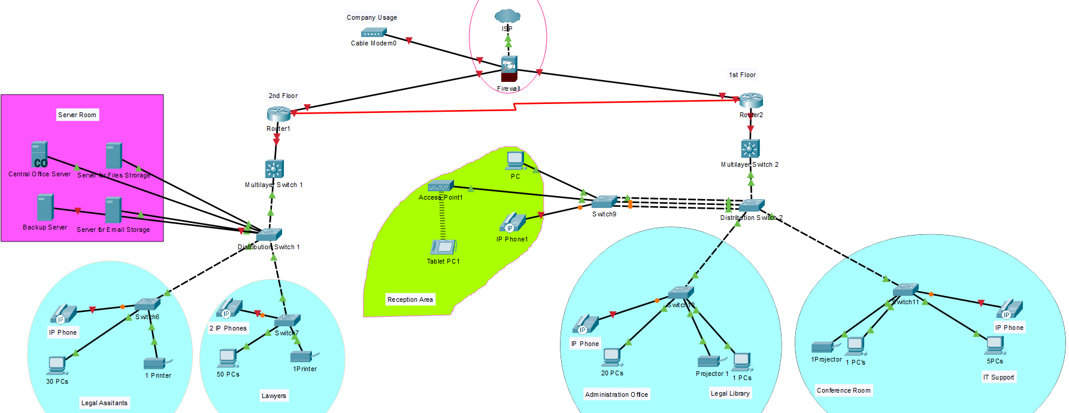
Colombo Branch (Main branch)

Slide 7
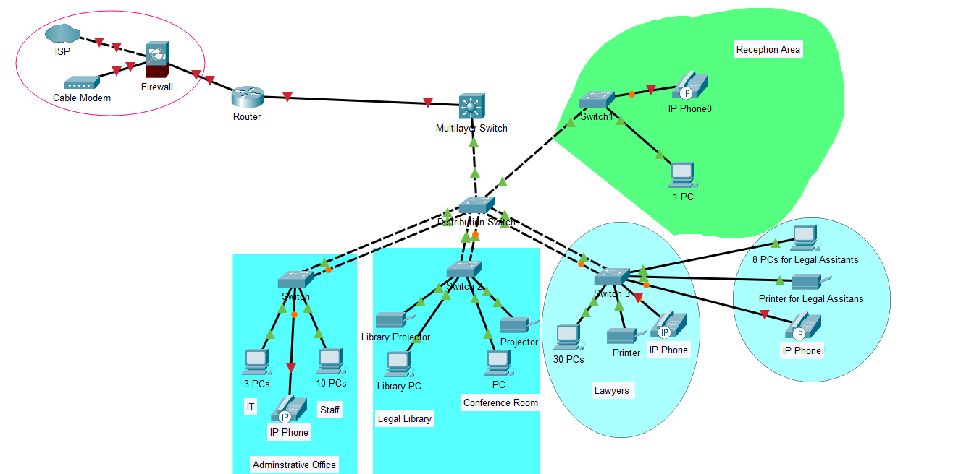
Sub branches
Kandy
Galle
Jaffna

Slide 8
Physical Topology Diagrams

Slide 9
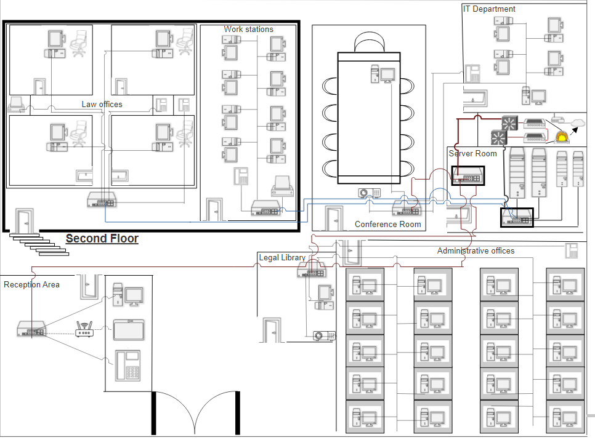
Physical Topology Diagram- Main Branch

Slide 10
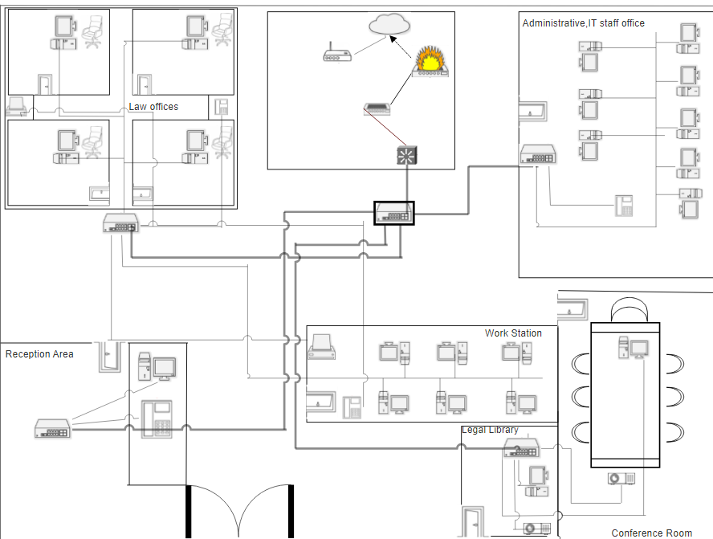
Physical Topology Diagram-Sub Branches

Slide 11

Real World Network Devices

Slide 12
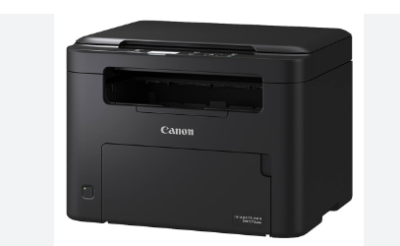
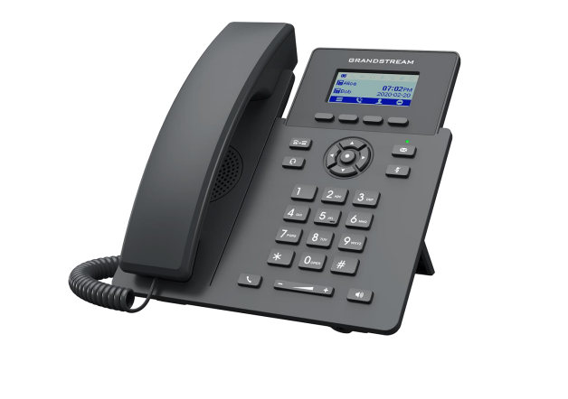
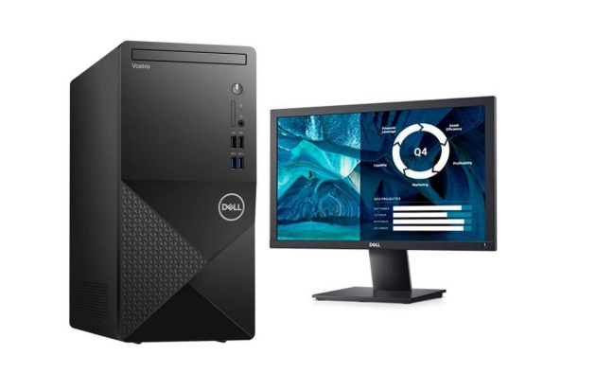
Desktop
Printer
IP Phone
Vendor: DELL Technologies
Model name: Dell Vostro 3910 – i5
Vendor: Canon
Model name: Canon G4010 ink tank printer
Vendor: Grandstream
Model name: Grandstream GRP 2061

Slide 13
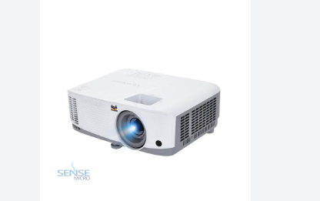
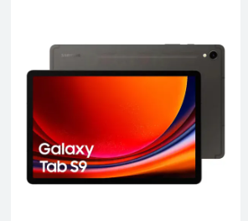
Projector
Tablet
Vendor : Samsung
Model name : Samsung Galaxy Tab S9
Vendor : ViewSonic
Model name : ViewSonic PA503S

Slide 14
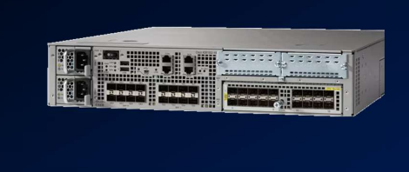
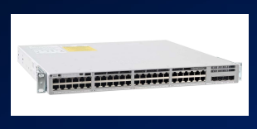
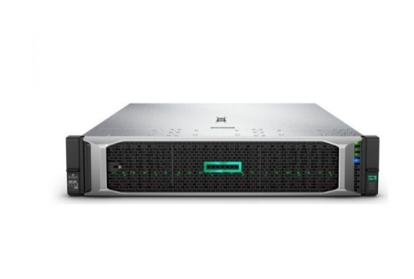
Core Network
Routers (Cisco ASR 1000 series) –
Essential for interconnecting different networks, high performance, scalability and advanced routing capabilities, built in firewall, VPN and advance security features, offers SD-WAN support.
Switches(Cisco Catalyst 9300L-48P-4X-A switch)-
Power over ethernet support, available 48 ports, security features.
Central office server (HPE DL380 Gen10 8SFF NC CTO server)-
Excellent reliability and security features, great for virtualization, databases and general enterprise tasks.

Slide 15
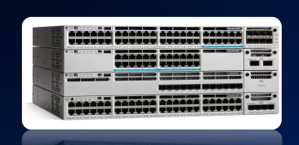
Distribution Network
Multilayer Switches(Cisco Catalyst 3850 series) –
Layer 3 routing, supports 1G and 10G uplink ports, advanced security options, allowing them to route traffic at high speeds, high availability and simplified management.
Routers- Routers may also needed for the distribution level to provide additional routing capabilities and redundancy.

Slide 16
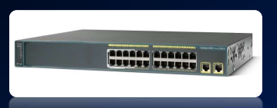
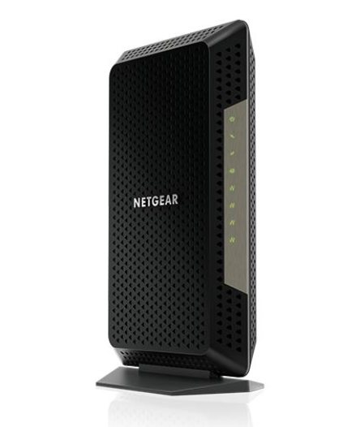
Access Network
Gigabit Ethernet switches (Cisco Catalyst 2960 series) -
provide high-speed connectivity to end user devices,
offer Gigabit Ethernet ports, PoE support for
powering devices like IP phones and wireless access
points, and robust security features
Netgear Nigthawk CM1200 (DOCSIS 3.1) cable Modem
Multi-gig speeds, supports high bandwidth
applications and offers four gigabit Ethernet ports
for wired connections.

Slide 17
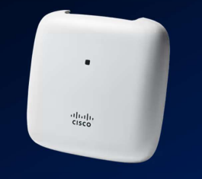
Wireless Network
Wireless Access Points ( Cisco Aironet 3802i Access Point)
Offers enterprise-grade wireless connectivity, advanced security protocols and centralized management, provides reliable wireless connectivity to end devices such as smartphones and laptops across all branches.

Slide 18
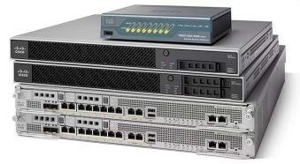
Security
Firewall (Cisco Adaptive Security Appliance Firewall ASA)
Helps organizations increase capacity and improve performance, Meets the unique needs of both the network and the data center, Offers integrated IPS, VPN, and Unified Communications capabilities, Adds security to the network.

Slide 19

Management
The network will be managed using a centralized network management system that will allow the IT department to monitor and control the network devices from a single location.
Network Management System (e.g. : Cisco Prime Infrastructure) -
offers centralized management and monitoring of network devices, allowing IT administrators to efficiently configure, troubleshoot, and optimize the network infrastructure.

Slide 20
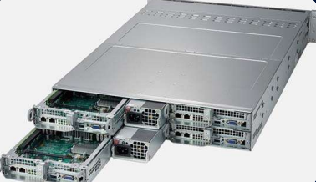
Server – Supermicro Super Server 2014TP – HTR
• Dual Intel Xeon Scalable processors for high-performance
computing
• Supports DDR4 ECC registered memory and various
storage options
• Flexible networking connectivity with onboard Gigabit
Ethernet ports
• Reliability with redundant power supplies, cooling fans and
remote management features.

Slide 21
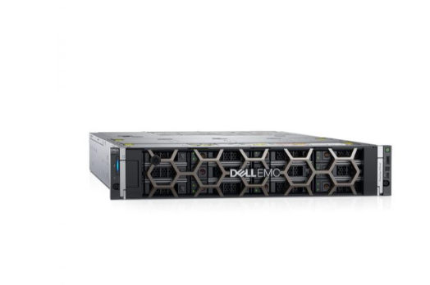
Backup and redundancy
Backup server (DELL PowerEdge R740xd Server)
Offers flexible storage and large memory capacity, fast
data processing, made with enterprise -grade components,
suitable for various workloads.

Slide 22

Appropriate Media Types

Slide 23
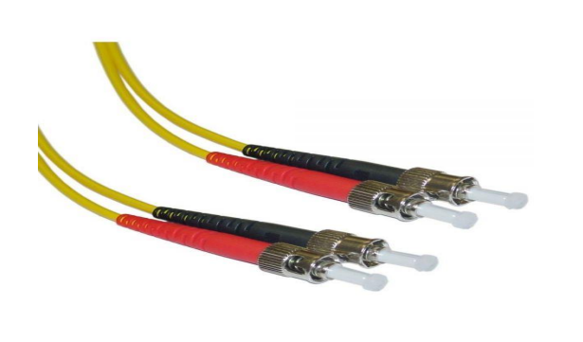
Fiber Optical Cables
ST-ST-10-Meter-Singlemode-FiberOptic-Cable
Fiber Optic Cable, ST/ST, Single mode – 1
Meter (9/125 Type)
Low signal loss
high speed performance
secure connection

Slide 24
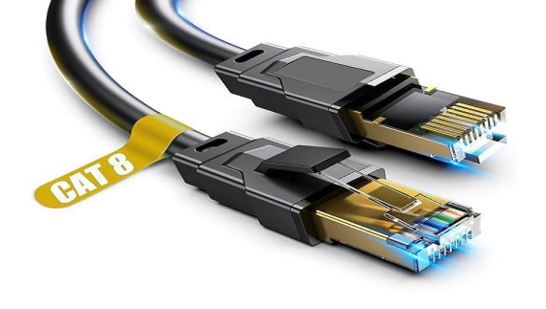
Ethernet Cables
Cat 8 Ethernet Cables 10 feet.
provide reliable wired connections
offering high bandwidth and low latency
support Gigabit Ethernet speeds
suitable for handling the network traffic
within the premises.

Slide 25
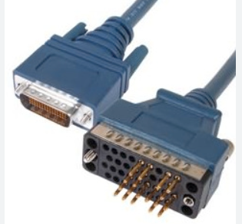
Serial DCE Cables
Used for better communication between various networking devices and computers.
Transfer reliable data
Protocol is straightforward.
Cost effective

Slide 26
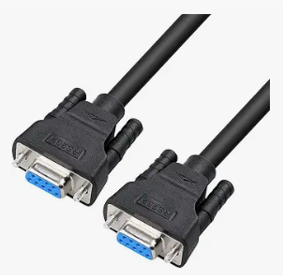
Crossover Serial cables
Essential for direct communication between two similar devices.
Enabling smooth communication between devices in networking.

Slide 27
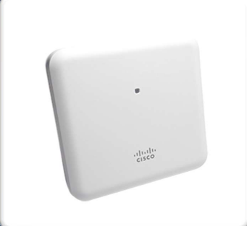
Wireless connection
Cisco Aironet 2800 Series.
• Wi-Fi provides convenient wireless connectivity for mobile devices, offer increased bandwidth and improved performance

Slide 28

LAN and WAN Technologies

Slide 29
LAN Technology
Gigabit Ethernet
• Offers speeds up to 1GB per second with potential for higher speeds like 10GB per second .
Fast data transmission .
Support high speed internet connections, facilitating fast access to online services and multimedia content.
Accommodating multiple devices simultaneously.

Slide 30

Wi-Fi
Enables wireless connectivity
• Providing flexibility for device placement and mobility for users
• Users can connect to the network from anywhere
• Supporting the mobile devices such as laptops, smartphones, tablets
• Scalability and convenience
• Allowing employees to work from anywhere
• Integration with IoT Devices

Slide 31

WAN Technology
ISP- Internet Service Provider (SLT Mobitel)
Core Efficiency: Readily available internet connections to create a secure overlay network, SDWAN solutions typically utilize affordable, reduce costs.
• Increased Bandwidth Efficiency: manages and optimizes network traffic flows, dynamically routing data
across the most efficient path based on real-time network conditions.
• Enhanced Network Performance: Quality of Service (QoS), traffic shaping, give more responsive and
reliable network experience for users.
• Managed by SLT Mobitel: can handle tasks such as network monitoring, maintenance, troubleshooting
and providing peace of mind to the organization.
• Future-Proofing: Allowing organizations to adapt to changing business needs and technology
advancement.

Slide 32
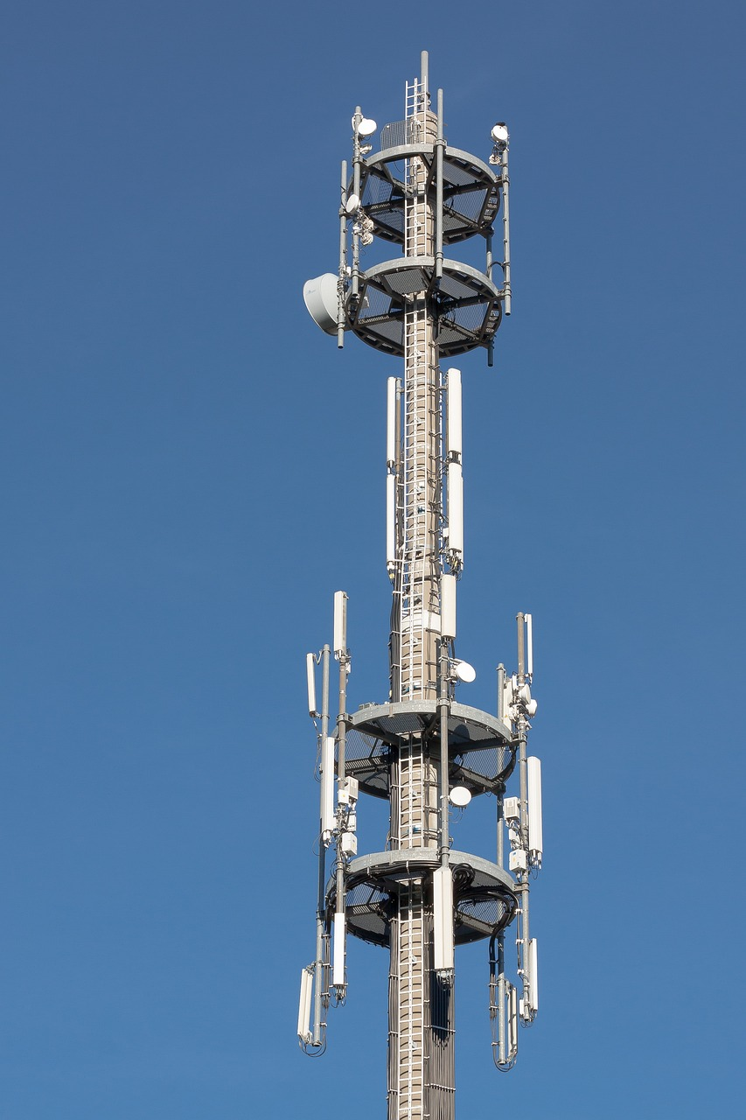
Cellular
Used by the ISP to interconnect all 5 branches.
Wide coverage
High flexibility for packet switching
Acts as a failover option in case the primary wired WAN connections fails.
Very scalable

Slide 33

Protocols

Slide 34
Application Layer
• HTTP/HTTPS: used for communication between web browsers and servers.
• SMTP: utilized for sending and receiving email messages between email servers.
Presentation Layer
• SSL/TLS: provide encryption and authentication mechanisms for secure communication over the internet.

Slide 35
Session Layer
• TCP: establishes and maintains reliable connections between devices on a network, it ensure data delivery by managing packet sequencing and error detection.
Transport Layer
• IP: responsible for routing packets between devices across interconnected networks.
• UDP: connectionless transport protocol that offers low – latency, unreliable data transmission.

Slide 36
Network Layer
• IPv4: fourth version of the internet protocol, responsible for addressing and routing packets between devices on a network, IPv4 addresses are 32 bits long
Data Link Layer
• Ethernet: It defines the format of data packets (frames) transmitted over Ethernet networks and provides mechanisms for addressing, error detection, and flow control.

Slide 37
Physical Layer
• Fiber optic and Ethernet cables: Fiber optic cables use light signals to transmit data over long distances at high speeds.
• Ethernet cables: such as Cat5e, Cat6 or Cat6a are commonly used for local connectivity within buildings or campuses, provide reliable, wired connections between network devices .

Slide 38

IP Addressing Schema

Slide 39
Private IP Range
Class B Private IP address range
172.16.0.0 – 172.31.255.255
Class A address range is too large.
It will waste a large amount of IP addresses.
Class C is too small.
It is not sufficient to accommodate the required amount of IP addresses.

Slide 40
IP Addressing schema with VLSM
Branch | Number of employees | Network Address | 1’st usable IP address | Last usable IP address | Broadcast Address
Colombo | 126 | 172.16.0.0/25 | 172.16.0.1 | 172.16.0.126 | 172.16.0.127
Kandy | 62 | 172.16.0.128/26 | 172.16.0.129 | 172.16.0.190 | 172.16.0.191
Galle | 62 | 172.16.0.192/26 | 172.16.0.193 | 172.16.0.254 | 172.16.0.255
Jaffna | 62 | 172.16.1.0/26 | 172.16.1.1 | 172.16.1.62 | 172.16.1.63

Slide 41

Overall Budget

Slide 42
Device | Quantity | Price
Desktop | 235 | 729$*235 = 171,315$
Printer | 8 | 293$*8 = 2344$
IP Phone | 18 | 75$*18 = 1350$
Projector | 8 | 247$*8 = 1976$
Tablet | 1 | 533$*1 = 533$
Crossover Serial cables | 17 | 9.95$*17=169.15$
Cisco ASR 1000 series router | 5 | 8800$*5 = 44000$
Cisco Catalyst 9300L-48P-4X-A switch | 19 | 3500$*19 = 56500$
HPE DL380 Gen10 8SFF NC CTO server | 1 | 2377$*1 = 2377$

Slide 43
Cisco Catalyst 3850 series switch | 5 | 3650$*5=18250$
Cisco Catalyst 2960 series Gigabit Ethernet switch | 5 | 262$*5 = 1310$
Cisco Aironet 3802i Access Point | 1 | 408$*1 = 408$
Cisco Adaptive Security Appliance Firewall (ASA) | 1 | 199$*1 = 199$
Supermicro Super Server 2014TP – HTR | 2 | 8189$*2 = 16378$
DELL PowerEdge R740xd Server | 1 | 2898$*1 = 2898$
ST-ST-10-Meter-Singlemode-FiberOptic-Cables | 1 | 16.95$*1=16.95$
Copper straight through | 44 | 23.66$*44=1041.04$
Serial DCE cables | 1 | 14.99$*1=14.99$
Total Budget | 302 830.13$

Slide 44
References
(Details about Devices) https://www.netacad.com/cisco-packet-tracer
https://www.youtube.com/watch?v=VwN91x5i25g&list=PLBlnK6fEyqRgMCUAG0XRw78UA8qnv6jEx
(Prices for Devices) https://www.router-switch.com/
https://www.geeksforgeeks.org/
(Difference of Central office server and Server) https://community.cisco.com/t5/network-management/different-between-central-office-and-point-of-presence/td-p/4095504
(Topology images for devices) https://www.softwareideas.net/computer-network-diagram, https://images.app.goo.gl/73kLWsKgznv8vWWcA.

Slide 45

Questions ?

Slide 46


